Slide 1
SharePoint Analyst Series
The Build Process

Slide 2
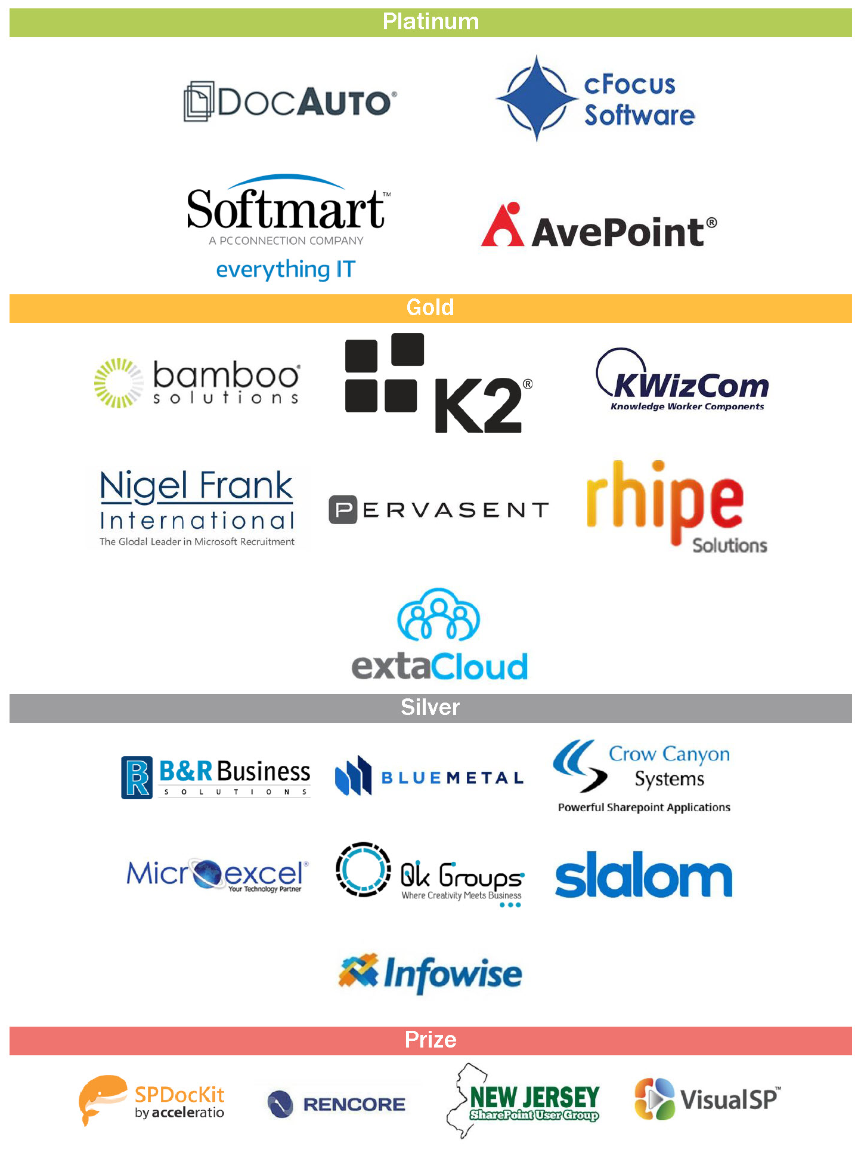
Thank You EVENT Sponsors
We appreciated you supporting the
New York SharePoint Community!
Diamond, Platinum, Gold, & Silver have tables scattered throughout
Please visit them and inquire about their products & services
To be eligible for prizes make sure to get your bingo card stamped by ALL sponsors
Raffle at the end of the day and you must be present to win!

Slide 3
Conference Materials
Slides / Demo will be posted on Lanyrd.com
http://lanyrd.com/2016/spsnyc
Photos posted to our Facebook page
https://www.facebook.com/sharepointsaturdaynyc
Tweet Us - @SPSNYC or #SPSNYC
Sign Up for our NO SPAM mailing list for all conference news & announcements
http://goo.gl/7WzmPW
Problems / Questions / Complaints / Suggestions
Info@SPSNYMetro.com

Slide 4
Visit ExtaCloud’s booth for wrist bands!
Scallywag's Irish Pub
508 9th Ave, between 38th & 39th.
[6 minutes walk]
Scallywags also serves food.
http://www.scallywagsnyc.com/

Slide 5
Agenda
What is a SharePoint Analyst?
Gathering Requirements
Documenting the Build Plan/Architecture Plan
Plan Permissions
Plan Information Architecture
Plan Site Columns/Content Types
Plan Workflows
Build

Slide 6
What is a SharePoint Analyst?
SharePoint analysts are people who work with the client to transform requirements into action. They are business analysts who specialize in the SharePoint platform. This is an industry term now, but many companies still call them SharePoint consultants or knowledge managers.
Notes:
Further Reference:
http://www.nothingbutsharepoint.com/2010/11/28/what-makes-a-good-sharepoint-analyst-aspx/
http://www.slideshare.net/michalpisarek/the-importance-of-a-business-analyst-on-sharepoint-projects

Slide 7
Gathering Requirements
Have the customers share their pain.
SYBOK: Your pain runs deep. J'ONN: What do you know of my pain? SYBOK: Let us explore it ...together. ...Each man hides a secret pain. It must be exposed and reckoned with. It must be dragged from the darkness and forced into the light. Share your pain. ...Share your pain with me and gain strength from it. J'ONN: Where did you get this power? SYBOK: The power was within you. J'ONN: It is as if a weight has been lifted from my heart. How can I repay you for this miracle? SYBOK: Join my quest.
Notes:
https://www.youtube.com/watch?v=7N7c5nf1c50
As someone with a lot more knowledge of SharePoint than whoever you are helping, you must make your CONVERSATION about their pain. I love this scene from Star Trek V where Sybok finds J’onn in the desert. It is true KM in action. I’ve had this conversation with people I’ve helped almost verbatim. Once you show them what they can do with SharePoint, they will be happy to help you with your quest, to get everyone else on board the SharePoint train.
Don’t ask them if they need a library, create it, and wipe your hands. Ask them what the pain really is. These sections are going to tell you something like, “I need a place to keep track of XXXX files.” That is their pain statement. Ask them questions: “Who adds documents?” “Who consumes the content?” “Do some people need to see more or less than another group of people?” “Is there an approval process to put documents in there?” Be exhaustive. At this point, there aren’t many bad possible questions.
You need to think of all of the what-if scenarios there could be. You need to know how they want to present the information. You will need to learn a little about their business process. Don’t try to change the nature of the process too much. Business needs drive solution creation. Don’t force the customer into a solution that doesn’t fit what they want because you think it’d be a better way to do his job. They’ve been doing it 20 years for a reason. It might be a bad reason, but let the customer figure that out and give you the additional requirements.

Slide 8
Documenting the Build Plan/Architecture Plan
Before you build ANYTHING, write out what the end goal is.
Focus on the logic structure of the data.
Focus Areas
Permission Architecture
Information Architecture
Workflow Structure
Page Layouts
Views
Notes:
I’ll make available a generic architecture plan to you all after the session. In my build plans I cover everything I can think of that I might need to configure. Build plans will always be very different from each other, however, because each solution tends to be very different. One customer might ask for something where you build a single library. Done. Point. Another customer might give you something where you end up creating five subsites, multiple libraries and lists on each, and dynamic permissions. Get good requirements, and get an even better POC. Regardless of how well you work the customer over for requirements, you will need to ask questions again because something just doesn’t look right, you have a suggestion for a view so that the customer won’t need to scroll left and right to see all of the data, or you find a technical issue that makes you look for a workaround. Whatever it is, you will need to have someone with that office who can answer your questions.

Slide 9
Plan Permissions
Permissions can be very difficult for people to grasp when it comes to SharePoint.
Groups describe the people, not what they have access to.
It is better to have 12 small groups with contribute rights to one list than 80 people in 1 group with contribute rights to that same list.
Use your groups to help scope your people pickers.
When do you create new libraries on your site?
Notes:
I’ve done so many presentations on permissions that I’m going to force myself not to go into too much depth here. Just remember that your environment dictates a lot of how you do this. If you are managing access for a dozen people, you will do it far differently than if you were managing the access of 12,000 people. All of your permission groups define the people in those groups, not what they have access to. You have ABC Site Owners, ABC Site Members, and ABC Site Visitors as a default thing in SharePoint. It doesn’t mean it is set in stone. If you have a company site with ABC, DEF, GHI, and JKL subsites, you might need to create ABC Visitors, DEF Visitors, GHI Visitors, and JKL Visitors. You might, but more often than not, you can just reuse Company Visitors for all of the subsites and lessen your management burden. It also means that you can have ABC Members, DEF Members, GHI Members, and JKL Members as groups with a contribute permission on the company site instead of managing one big group, Company Members. Break things down in to manageable chunks.
When you have these smaller permission groups, you can have a task list or anything else with a people picker column and scope that column down to the group. Instead of searching through 12,000 people in the company in your people picker, you can click on the address book next to the field and see just the 12 people who are possible options on that particular list. It really helps when you might have a few people named John Smith in your organization.
When do you create new libraries? You do it when the content is vastly different or when the permissions are different. If you break permission inheritance on an evil folder (all folders are evil) in a library to change the permissions, you’ll end up with a lot of people or groups having limited access when you check permissions. It can become painfully hard to find that one folder where you broke inheritance in a larger library. You can always use dynamic permissions based on metadata; but, as a general rule of thumb, I advise against breaking permissions below the library.

Slide 10
Plan Information Architecture
Information architecture determines how sites organize and present content, such as web pages, documents, lists, and data to users. It is the practice of organizing and labeling sites, content, communities, and software to support usability. Architecture is vital to increase the accessibility of information to the organization.
When do you build a site versus a page?
Should you use one big list or five smaller lists?
Should you use one big list and have all of the subordinate offices use it, or should you use a list on each subordinate office’s site to aggregate up?
There is no one right way to do things, but plan for longevity and scalability.
Notes:
Site structure is important. It is part art and part science, and you want to give your users a positive user experience. You don’t want to force your users to drill down eight layers to not find the content they want and make them go back up and drill down a different path. Keep the structure as flat as possible to keep the users on one site when you can. Keeping users on your pages, is always ideal to sell the site.
When do you build a site versus a page? A general rule of thumb for me is to create subsites only when you have a lot of lists and libraries that will have a different permission architecture than the rest of the site. Also, if you---usually because of the number links---need to have a different look to the Quick Launch than the parent site, you might need to create the subsite even if the permissions don’t change. More often than not, however, it will be because of the permission architecture. Remember, however, to reuse any permission groups you already have rather than creating new ones. If on site ABC, I have a permission group for the leadership to have contribute rights to everything, I don’t need to create a new group in the subsites. I see it happen all of the time. If you permission map your site and look at all of the members of each of your groups, you’ll often find that you have the same three or four people in a bunch of different groups because someone failed to check if there were other groups that would have worked.
Should you use one big list or five smaller lists? Depends. It mainly depends on who will own the content. Your organization could have one giant library where all of the smaller offices put all of their stuff. It’ll end up with folder sprawl like your shared drive and get very unmanageable. It could also put smaller libraries in each of the section’s sites. You can then aggregate that content with a Content Query Web Part to find all of the recently added documents in the whole organization.
Everything will depend on your level of knowledge about the SharePoint platform, your level of permissions, and the business requirements. The business requirements drive everything. Push back when it is technically off because of how SharePoint works, but if the customer wants it pink and nothing says it can’t be pink, MAKE IT PINK. You can make suggestions and get design gurus to help make your case. I would also say to push back if it unnecessarily requires someone to add code, especially if it is for mere cosmetic reasons. You also want to keep the branding similar throughout the whole organization, so avoid using big icons on one site with one color theme that is completely different from the icons on another site with a different color theme.
Lastly, I’d highly recommend that you do right by your customers and make them aware of the level of effort you require to carry out cosmetic changes. Ask them if they will get the return on investment to pay you for 40 hours to make it pretty.

Slide 11
Plan Site Columns/Site Content Types
What is a content type?
Why use site columns and site content types?
Where do I build site content types?
Notes:
“A content type is a reusable collection of metadata (columns), workflow, behavior, and other settings for a category of items or documents in a Microsoft SharePoint Foundation 2010 list or document library. Content types enable you to manage the settings for a category of information in a centralized, reusable way.” That is Microsoft’s definition of a content type. Think of it this way; it is a type of content. Content types are not file types like .docx, .pptx, or .xlsx. You could make content types that were blank documents, presentations, or workbooks, but you won’t get anywhere near the same bang for your buck. Think of each type of document you write as a content type. You have meeting minutes, agendas, visitor presentations, leadership presentations, townhall presentations, quarterly training presentations, or---hey---SharePoint build plans. Now think about what everyone else in your organization does that they repeat over and over, most often using the latest and greatest template someone emailed them only to find out that they got a newer template in a different email they didn’t open yet. Using our templates, you can create content types where the current template is the only one available when they start.
Don’t forget about your lists. Every item you put into SharePoint uses content types. The most common and most basic one is the Item content type. From it, all other content types come into fruition. There are parent-child relationships, and changes to the parent can affect the child content types. In the calendar lists, you have the Event content type. In task lists, you have the Task and Summary Task content types. The Summary Task is a special content type because it is based on a folder. Yes, folders are a content type, and---more importantly---you can add metadata to them.
What is metadata? Metadata is why we create content types. Metadata is the properties or characteristics of the item, whether it is an event or a document. With a document, you have subject, author, description, etc. Can you think of a few more? With an event, you have the location, start time, end time, attendees, etc. Can you think of a few more? So when you want to have your build plans in the same library as your meeting minutes and your other documents, do you add columns directly in the library for meeting name and meeting time when your build plans don’t have that type of metadata? Of course not, you create all of these content types well ahead of time and drop the ones into the library that you will need. That is why planning is so important. When you are meeting with the customer, you really need to dig and find out what types of content the office will add to each library.
Why do we add metadata? It is so we can filter, sort, and group our content to make anyone coming to get it more successful at finding it. If you don’t care how easy it is for someone to find it, why are you even putting it into a collaborative environment like SharePoint? How easy do you want to save the file versus how easy you want to find the file is what we are talking about, because the filenames that some folks use will not help you. They might fat-finger an acronym. The file could end with draft final v2 final 5 Oct 2014.docx. Don’t ask me why people do this, but everytime you send out a file for edits, you will get a different naming convention coming back to you. You cannot fix all of the filenames that already exist, so it is better to use the metadata.
Some metadata can be very static. From site to site in the whole organization, you might have a standard way you want to refer to the fiscal year if someone needs to use that. Do you allow everyone to type their own thing? You’ll end up with FY2014, FY 2014, FY 14, or FY14, maybe more. Do you make it a choice column on each list? Never. You’ll end up with the same problem because some other analyst is using FY 2014 when you want to just use FY14. The best thing to do is to create a site column at the root of the site collection with the options your organization wants. Then, whenever you need it in a site or list content type, you can add the standard for the organization. Who defines what the standard will be? NOT YOU! Not usually anyway. Talk to the stakeholders. No good policy is ever made in a vacuum. Get consensus.
Now do you build your content types on the site you are working with or at the top of the site collection? It depends. If the office you are helping uses the same definition for what your site columns or content types are as all of the other offices, build the content type as high as possible. If you don’t have permissions to build it higher, talk among all of the other analysts and get everyone to agree and have someone else build it higher. This is so that everyone can use the same thing. Being able to recycle and reuse our work in SharePoint, reduces your time building stuff in the future. Be a SharePoint hugger. If you didn’t understand the environmentalist humor there, I apologize.

Slide 12
Content Type Planning
 | Base Content Type | Child 1 CT | Child 2 CT
Title | X | X | X
Filename | X | X | X
Choice Column 1 | X | X | X
Choice Column 2 |  | X | X
Choice Column 3 |  |  | X
Multi-line Text Column |  |  | X
Put it all on paper first.
Don’t forget to build your look up lists first.
Create a base content type for all of your child content types. Think of how you can cascade additional columns to save time at creation.
Year-based content types could add a new dynamic, so base FY15 on FY14 and FY16 on FY15 and so on.
Notes:
Here is a planning activity. This is how I plan for creating content types. I’ll give you copies of a template that I use for this after the session. Figure out all of your columns, and add them down the left. Figure out all of your possible content types, and add them across the top.

Slide 13
Example: Project Plans and Meeting Minutes
 | New Doc Content Type | Meeting Minutes | Project Plan
Title | X | X | X
Filename | X | X | X
Classification | X | X | X
Project |  | X | X
Document Status |  |  | X
Review Comments |  |  | X
Put it all on paper first.
Don’t forget to build your look up lists first.
Create a base content type for all of your child content types. Think of how you can cascade additional columns to save time at creation.
Year-based content types could add a new dynamic, so base FY15 on FY14 and FY16 on FY15 and so on.
Notes:
So this is something we could come up with. We have a new base content type for ALL of our documents. I often work in a classified environment, so I want the classification on all of my documents. We want the name for the project tied to our meeting minutes to help us sort them. We want the document status, draft or final, along with all of the comments from the review before the document is final. You can think of a bunch of metadata you could use, just remember to have some balance in there. If you ask for too much, people just won’t add it. It is the human condition.

Slide 14
Plan Views
Excel vs Access way of thinking
No spaces
Put them on pages
Notes:
The content type planning workbook has a worksheet to help with these views. Line up all of the columns in the order you need, identify how you want to filter, group, and sort, and plan out every view first. You need to think of these lists like databases, not spreadsheets. Don’t forget that you will see the little Access icon in the corner of most list views. A view is essential a query on your data in the database. Each content type is a table. Those views query across your tables of data. You can join all of it, or just use one.
When you create your view names, don’t use a space in the name. After you create it, you can add them back by modifying the view. It is just about keeping the URL pretty.
Plain old lists look boring and often lack a lot of context, especially if you are using acronyms in the column headers. Create pages to put them on. In one of the other zones on the page, you can add information about why the list exists, how you use it, and other instruction information.

Slide 15
Plan Workflows
If the customer won’t sign his or her name to what the workflow is, don’t build it.
You cannot assume to know their workflow.
Ask what-if questions and challenge the workflow the customer gives you.
What can you do with a workflow?
Notes:
Often, I have customers tell me they want to automate a process because they want to reduce the burden on them. Unfortunately, the reason they feel the burden is because not everyone involved in the workflow knows his or her part. Asking them to draw out the workflow on paper is essential. Often, they’ll find holes in the workflow. They might think a document’s workflow should just go from Jim to Bob to Sally for approval. Then you need to challenge them---not to just be a pain---and ask them what the what-if scenario questions. “What if Bob is out of the office?” “What if Bob disapproves the document?” Do we need to keep track of why he disapproved the document?” “Do we need to keep track of what?” “Does the process start back over from the beginning if it is for document changes, or does the process stop completely?” “If Sally disapproves the document, does it go back to Bob before it goes back to Jim?” I can’t give you all of the possible scenario questions. As an analyst, you need to learn a little about their business to ask the right questions.
What can you do with a workflow? Well, a lot. Some of the most common ones I use is to change the content type of something one submits to another one for the person who got the submission. A work order would have X number of columns for the user to submit, but the workflow would change it from a submission content type to a work-in-progress content type with X+5 fields. After the work is done, you’d have another to change the content type to a final complete state with additional column to track metrics on how long it took to do the work, what quarter or month the work was done, and what the resolution was. You could have the generation of the complete content type generate a task in another list to add information to a knowledge base or have another workflow kick off to send an email to the user for a customer satisfaction survey. Another workflow I do often is to create dynamic permissions. If you have several different organizations contributing to one list or library, you can lock down in the advanced settings of the list to make whatever they add editable only by the person who added that. That is good in theory, but it encourages single points of failure. If someone from the ABC office adds something and goes on vacation, no one else from ABC can edit the item the guy added. If you use multiple permission groups, AS YOU SHOULD, on such a list, you can configure a workflow to give the whole group permission to edit the content instead.
Of course, what many of your customers will want is just an email to send something. Be careful with that. I’ve seen people live an organization and email continue to go to their Yahoo accounts. You could also end up with dozens of emails a day going out. The human condition of such a thing leads the recipients to have hundreds of these left unopen in the inbox. It can often be better for you to encourage the customer to set up individual alerts on a library so they get a daily or weekly digest of all changes based on what they want, and they can change the alerts themselves if they get too cumbersome to manage.

Slide 16
Build
Last phase of the process.
Steps
Create the permission groups
Create site columns
Create site content types for dependent lists/libraries
Create site content types for everything else
Create pages
Create lists and libraries
Add content types
Configure Views
Create workflows
Form Modification (UI/UX)
TEST!!!!!
Notes:
You can build things in this order or some other way, but it will be like putting on your underwear last. Then you’ll find that you need to take off your shoes, then your pants, then put everything back on in the right order. You might find that you will need to tweak this on occasion. One that I know I need to do often is if I have a need for a column that calculates off of columns from different content types. You must add those directly to the list after you have added the content types. If you put that kind of calculated column into the content type, you’ll have an error.

Slide 17
Questions

